Slide 1
Genre-Based Classification of Songs
Using Deep Learning Models
Martin Donaire

Slide 2
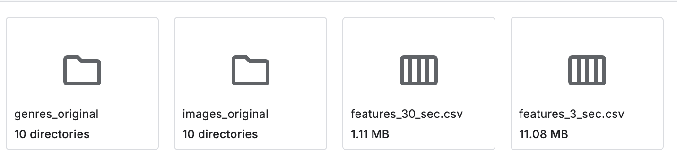
Introduction
Challenge: Music genres often overlap, making classification complex.
Objective: Classify music genres using deep learning models.
Why It Matters: Enhances music recommendation, playlist curation, and analysis.
Applications: Improves music streaming platforms, user experience, and music industry analytics.

Slide 3
Data Preprocessing
Dataset: GTZAN from Kaggle, 10 genres (e.g., hip-hop, rock), 100 audio files (30s each) per genre. It was preprocessed as follows:
Segmentation: Split each 30s track into ten 3s segments.
MFCC Extraction: Transform segments into Mel Frequency Cepstral Coefficients (MFCCs) to capture timbral/spectral features.
MFCC Settings: 22,500 Hz sampling rate, 2048 FFT window, 512 hop length, 13 MFCCs per frame.
Purpose of MFCCs: Compresses audio into perceptually relevant, image-like features for deep learning.
Data Splitting: 70% training (30% validation), 30% testing, stratified.

Slide 4
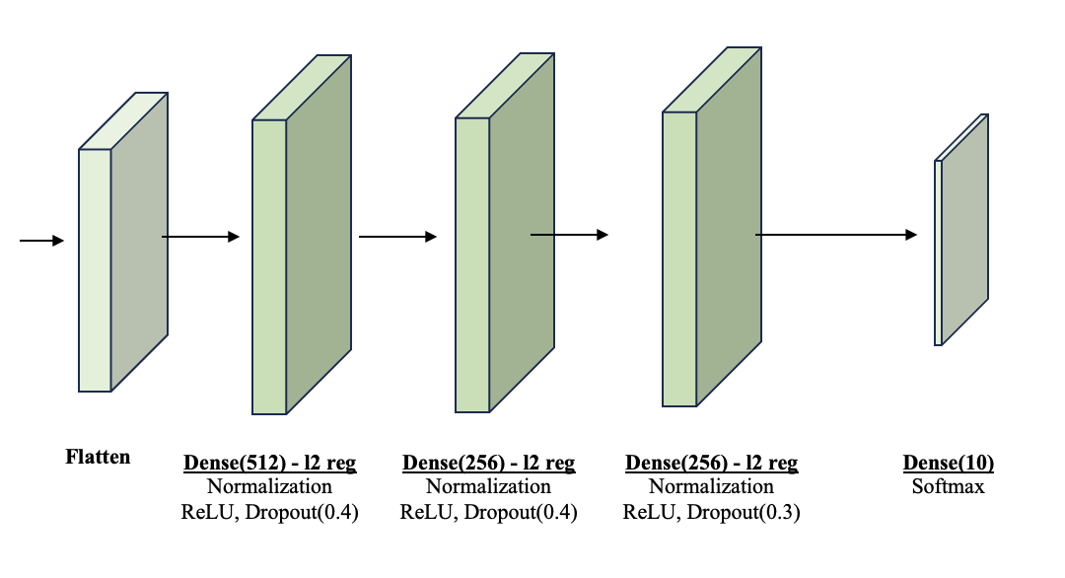
Model 1: Dense Neural Network
Architecture: Fully connected layers (512, 256, 64 neurons), flattens MFCC input (130x13) into 1D array.
Features: ReLU activation, L2 regularization (0.0005 penalty), dropout (40%, 30%), softmax for 10 genres.
Purpose: Simple and fast but struggles with localized audio patterns.
Training: Adam optimizer (0.0001 learning rate), sparse categorical cross-entropy, 250 epochs, batch size 64.

Slide 5
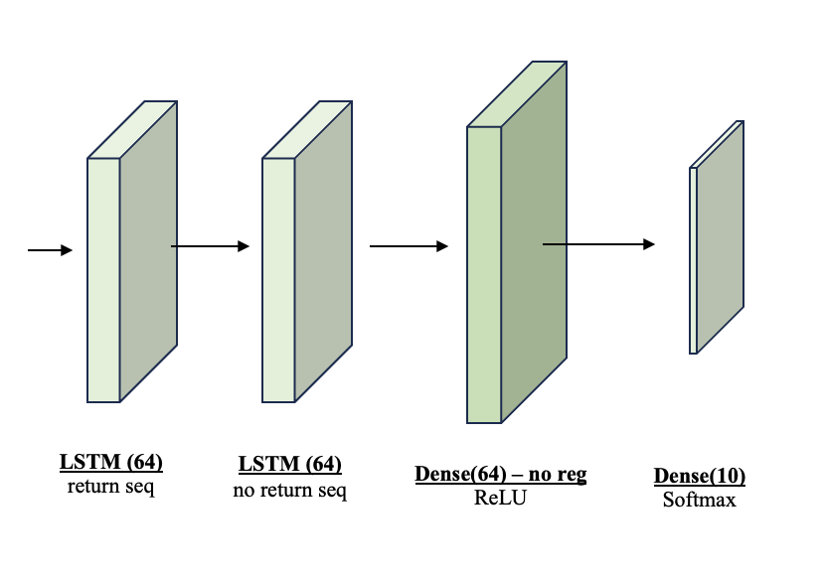
Model 2: Recurrent Neural Network
Architecture: Two stacked LSTM layers for sequential MFCC input (130x13), 64-unit dense layer, softmax output.
Features: Captures temporal dependencies, uses ReLU activation, softmax for 10 genres.
Purpose: Ideal for sequential audio data, limited by short 3s clips.
Training: Adam optimizer (0.0001 learning rate), sparse categorical cross-entropy, 250 epochs, batch size 64.

Slide 6
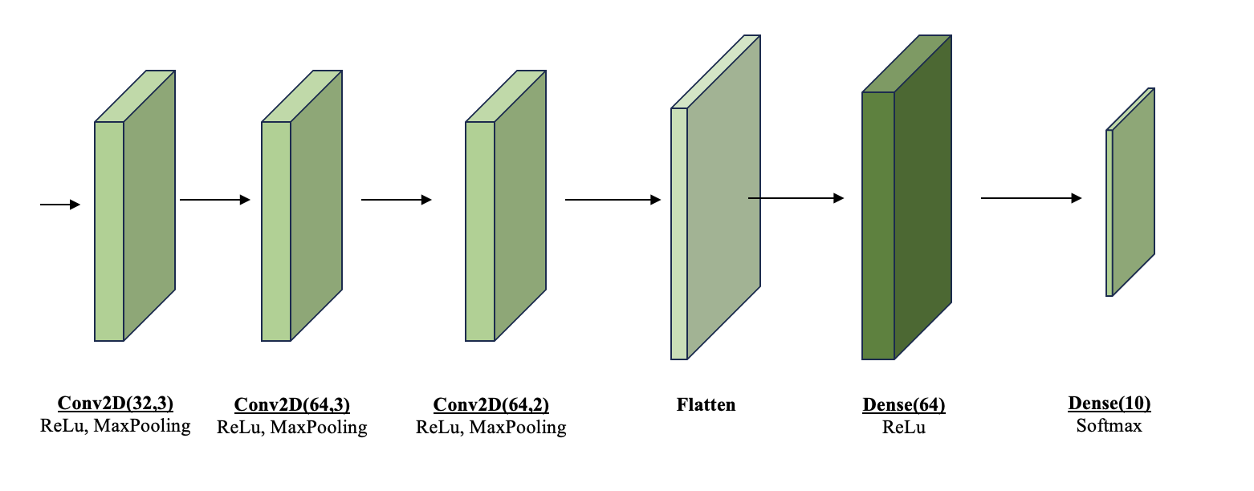
Model 3: Convolutional Neural Network (Base)
Architecture: Three convolutional blocks (32, 64 filters), ReLU activation, max-pooling (stride 2x2), same padding.
Structure: Flattens output, 64-unit dense layer, softmax for 10 genres.
Purpose: Captures spatial patterns in MFCCs, treating them as images.
Training: Adam optimizer (0.0001 learning rate), sparse categorical cross-entropy, 250 epochs, batch size 64.

Slide 7
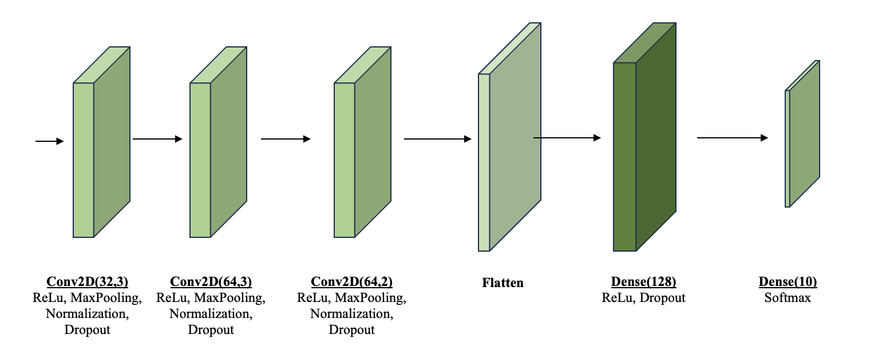
Model 4: Convolutional Neural Network (Enhanced)
Architecture: Builds on Base CNN with three convolutional blocks (32, 64 filters), ReLU, max-pooling.
Enhancements: Batch normalization after each conv layer, dropout (0.2, 0.1, 0.5), 128-unit dense layer, early stopping (20 epochs).
Purpose: Improves generalization and stability, excels at complex audio patterns.
Training: Adam optimizer (0.0001 learning rate), sparse categorical cross-entropy, 250 epochs, batch size 64.

Slide 8
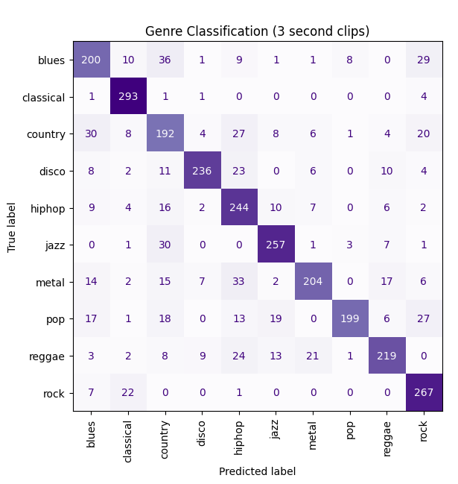
Model Performance
Accuracy Results:
DNN: 57.0% (weakest, poor at localized patterns).
RNN: 60.9% (better, limited by 3s clips, vanishing gradients).
Base CNN: 69.9% (effective for spatial patterns).
Enhanced CNN: 77.2% (best, due to regularization, data augmentation).
Key Insight: Enhanced CNN excels by treating MFCCs as images, boosted by dropout and time-reversed spectrograms.
Confusion Matrix: Strong for classical (293 TP), rock (267 TP); misclassifications in country (with blues), pop (multiple genres).

Slide 9
Summary and Future Direction
Key Finding: Enhanced CNN achieved 77.2% accuracy, outperforming DNN (57.0%), RNN (60.9%), and Base CNN (69.9%).
Implication: Regularized CNNs are highly effective for genre classification using MFCCs.
Limitations: Short 3s clips limit RNNs; genre overlap causes misclassifications.
Future Work:
Explore deeper or hybrid models (e.g., CNN+RNN).
Use longer audio segments or advanced data augmentation.
Fine-tune hyperparameters for better generalization.
Takeaway: MFCCs with regularized CNNs offer a robust approach for music genre classification.

